Slide 1
RF_SOC advanced usage: multi channel and multi chip synchronization
Francesco Contu
HS and RF System Solution Expert, Silica

Slide 2
Agenda
The need for synchronization: JESD204
RF_SOC features recap
Introduction to synchronization
Single chip synchronization
SYSREF requirements
Constant latency
Frequency Hopping
Alignement precision
Multi chip synchronization
Starter Designs

Slide 3
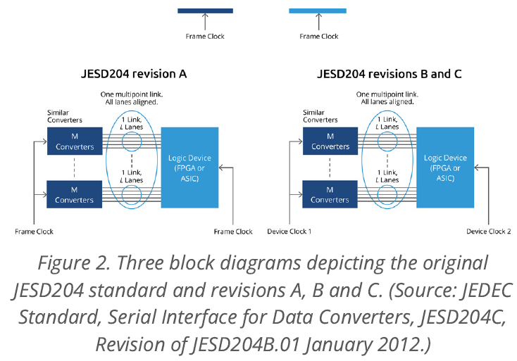
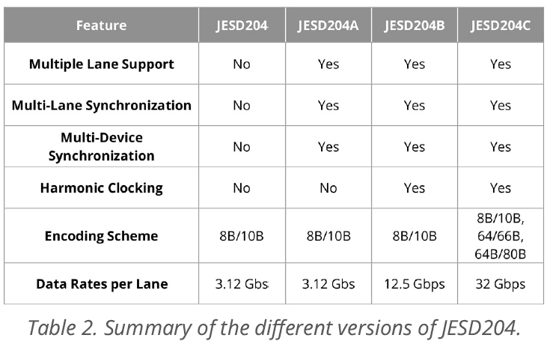
The need for synchronization: JESD204
Multiple ADCs and DACs connected to an array of antennas need synchronization
Same happens for multiple data acquisition or generation channels
Implemented by JESD204 standard starting from 2006
Normally used when connecting discrete ADC/DAC to FPGAs

Slide 4
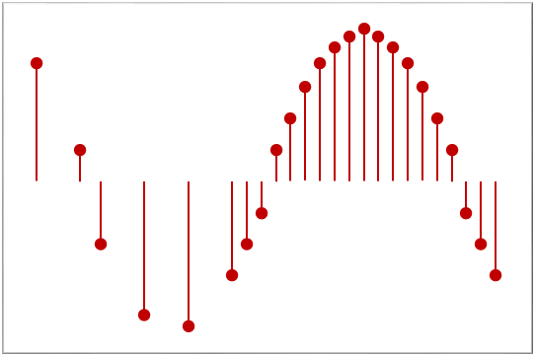
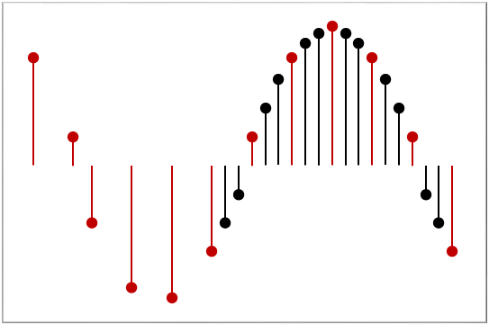
RF_SOC block diagram recap
Decimation
IQ Mixers
14-bit
5GSPS
RF ADC
RF-DSA
Gain/Phase Comp.
Zynq® UltraScale+™ RFSoC
4/8/12/16 channels
RF DAC
VOP
Processing System
Quad ARM Cortex-A53
Dual ARM Cortex-R5
RF DAC
10GSPS
DUC
Interpolation
On-Chip RF PLL
Buffer/Divider/Muxing
RF DAC
Programmable Logic
680K – 930K System Logic Cells
3168 – 4272 DSP Slices
SD FEC
4/8/12/16 channels
SD FEC
SD FEC
RF ADC
GTY
28Gb/s
DDC
RF ADC

Slide 5
Introduction to synchronization
RF_SOC supports synchronization for multiple ADCs and DACs
ADCs/DACs are divided in goups (aka Tiles)
ADCs/DACs in the same tile are synchronized by design
Multi Tile Synchronization (aka MTS) uses a SYSREF signal
  Similar to JESD204 but much simpler
  Precision can be down to a few ps
Multiple devices can be synchronized as well using MTS
  More advanced design requiring a proper clock distribution
  Precision depends on clock distribution, can be a few ps as well
Internal NCO phase can be synchronized as well

Slide 6
Internal Clock distribution, Gen 1 and 2 vs. Gen 3
Multiple
On-Board
Components
ZU2XDR
Gen 1 and Gen 2 need one clock per tile
Translates in skew if clocks not aligned
May cause tiles to be synchronized with +/- 1 T1 precision
Gen 3 allows the tiles to use the same clock
Tiles will always be synchronized with a couple ps precision
RF PLL
DAC x4
DAC x4
RF PLL
DAC x4
DAC x4
Gen1
Gen2
RF PLL
DAC x4
ADC x4
RF PLL
DAC x4
ADC x4
enhanced clock distribution
ZU4XDR
DAC x4
One External
PLL for an 8x8 or 16x16 Device
DAC x4
DAC x4
RF PLL
DAC x4
Gen3
DAC x4
ADC x4
DAC x4
ADC x4

Slide 7
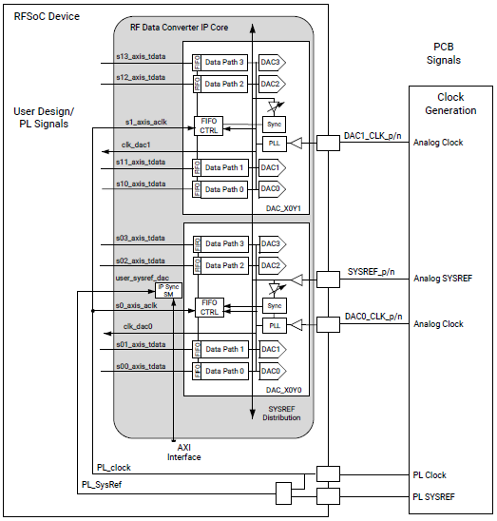
Multiple tiles block diagram
AD
AD
Typical setup requires:
1 ADC and 1 DAC clock
  In some cases a single clock is enough
1 PL Clock
2 copies of SYSREF (RF and PL)
  Do not strictly need to be in phase
  Phase should remain constant over time and power cycles
adc0
ADC1
AD
AD

Slide 8
SYSREF requirements
SYSREF must be synchronous with Fs
There are THREE basic rules to satisfy:
  It has to be an integer submultiple of FsADC/16 and FsDAC/16
  It has to be an integer submultiple of PL clock and any other clock which samples SYSREF
  MAX frequency 10 Mhz
Gen1 requires DC coupling to allow frequency hopping
  Gen3 can use both AC and DC coupling
It is possible to use different SYSREF frequency for ADC and DAC

Slide 9
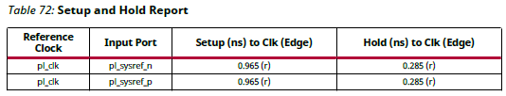
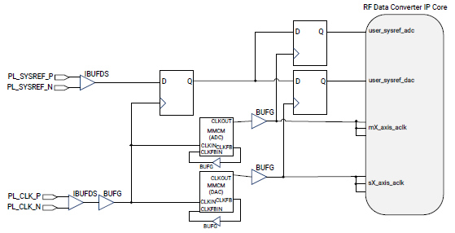
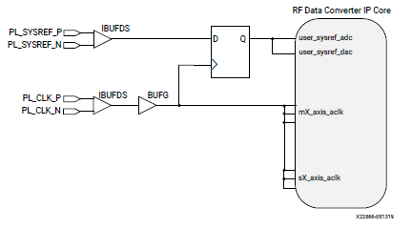
SYSREF capture requirements
Analog SYSREF will always be sampled correctly
  The device has an anti-metastability circuit inside
  For multi-chip alignment it is preferrable to generate SYSREF on sampling clock falling edge (more later)
PL_SYSREF requirements are stated in pg269

Slide 10
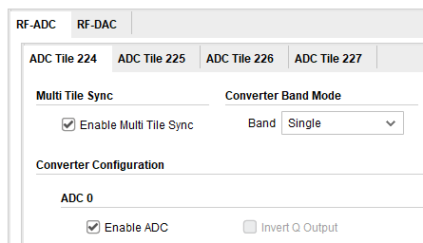
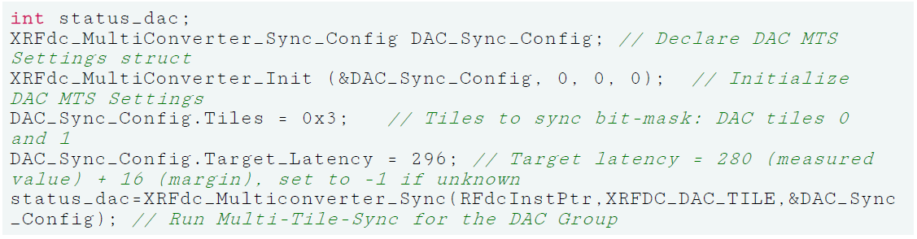
MTS procedure
Tick «Enable MTS» in Vivado
  Applies to every tile you need to synch
  First ADC tile must be 224
  First DAC tile must be 228
Assure that SYSREFs are enabled
Execute SW sequence as explained in pg269

Slide 11
What is target latency?
Used to have the same latency at every power cycle and/or device re-start
Requires to run the procedure two times at board bring up
First set «Target_Latency» to -1
MTS SW will return the measured value in T1 cycles
Add a margin of T1 cycles in multiples of axi streaming clocks
Run MTS again with the new value
  From now on that is the value to use
  Normally valid for a board architecture, no need to replicate the test on all the boards
Example: 8x decimation, 2x samples axi width
  Reported latency will be Nx16 (might be +1). Margin: 2x16=32
  Target latency to set: Nx16 + 32

Slide 12
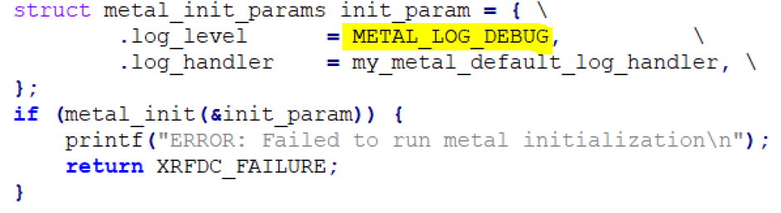
MTS SW Feedback
MTS can return a detailed report of alignment phases
  Need to enable it
Allows to read and correctly set desired latency
Useful for troubleshooting
Useful for SYSREF phase tuning if needed
May help to solve special cases, especially for multi chip applications

Slide 13
MTS SW Feedback details
The device automatically looks for SYSREF edges and marks those with a #
Then shifts SYSREF to the middle of the sampling clock
May help to solve special cases, especially for multi chip applications
Better generate SYSREF on the Sampling clock falling edge
SYSREF found far from sampling clock edge: SYSREF will be placed in the middle of the same clock cycle
metal info: ADC0: 011322220000000000000000000000000000000000000000000000000000*00000000000000000000000000#00000000000000000000000000111322200000000
Clock rising edge
SYSREF new position
SYSREF found position
Clock rising edge
SYSREF found on sampling clock edge: SYSREF may be placed on any of the adjacent clock cycles
metal info: ADC0:
00000000000000000000000000000000000000000000000000000000000000000000000000000000000011#13222000000000000000000000000000000000000
SYSREF new position?
SYSREF found position
SYSREF new position?
Clock rising edge

Slide 14
Consequence of SYSREF positioning
In case of position uncertainity, latency may change by +/- 1 T1 on different power cycles
In case of multiple boards, this can translate in +/- 1 T1 skew between the boards
A good reason to place SYSREF rising edge aligned with sampling clock falling edge
SYSREF found far from sampling clock edge: SYSREF will be placed in the middle of the same clock cycle
metal info: ADC0: 011322220000000000000000000000000000000000000000000000000000*00000000000000000000000000#00000000000000000000000000111322200000000
Clock rising edge
SYSREF new position
SYSREF found position
Clock rising edge
SYSREF found on sampling clock edge: SYSREF may be placed on any of the adjacent clock cycles
metal info: ADC0:
00000000000000000000000000000000000000000000000000000000000000000000000000000000000011#13222000000000000000000000000000000000000
SYSREF new position?
SYSREF found position
SYSREF new position?
Clock rising edge

Slide 15
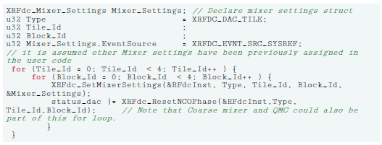
NCO usage
If NCO is used, the tiles need to reset the phase of all the channels in the same moment
  If this is not done, the channels will appear as they were not aligned
  Very common issue flagged by users
SW or HW sequence after MTS is completed
Set NCO update triggered by SYSREF
Disable SYSREF with SW command
Send NCO reset command to all involved ADC/DAC
Enable SYSREF with SW command

Slide 16
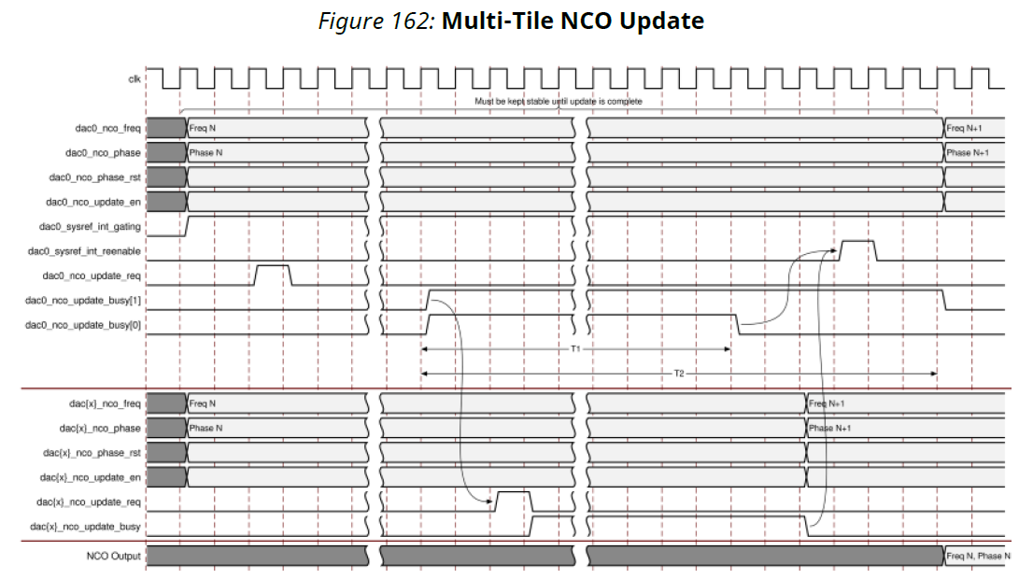
Frequency Hopping
Uses real Time ports

Slide 17
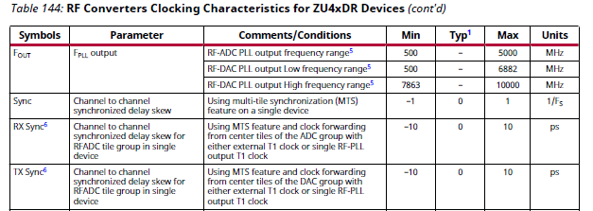
Alignement precision
Data sheet numbers are over PVT
A single device will exhibit very stable latency over VT and power cycles
Detailed Char Data available under NDA
Using different clock in different tiles (Gen1) may exhibit 1 T1 skew
  So Multi Chip requires very careful clocking to get a lower skew

Slide 18
Multi chip block diagram, single board
The two groups of clocks must have same phase
Generate SYSREF on sampling clock falling edge
MTS can be run in different moments
BUT NCO must be reset on the same SYSREF edge
So the chips must exchange «Busy» signals
  Or use a timeout strategy
Single Chip clock generator, 10 outputs minimum
RF_SOC 1
ADC_REFCLK
DAC_REFCLK
Clock
PL_CLOCK
SYSREF
PL_SYSREF
NCO Busy
RF_SOC N
ADC_REFCLK
DAC_REFCLK
PL_CLOCK
SYSREF
PL_SYSREF

Slide 19
Latency adjustment
Multiple chips on same or multiple boards might have different latency
This will result in misalignement by definition
Use a procedure similar to single chip constant latency
Run MTS on all the devices with «-1» option to get minimum latency
Pick the higher latency, add 2 cycle and run again all the devices with the new target latency
Requires the chips to exchange latency values

Slide 20
Busy signals
When all the NCOs of all the devices are ready SYSREF can be reanabled
Reenable must happen when SYSREF is inactive
Next SYSREF rising edge will update all the NCOs of all the devices in the same moment
SYSREF is max 10 Mhz, so timing is not an issue
PL_SYSREF 1 to N
BUSY DEVICE 1
BUSY DEVICE N
SYSREF_REENABLE 1 to N

Slide 21
Multi chip block diagram, multiple boards
Clock Generator board 1
Clock generation board
ADC_REFCLK
DAC_REFCLK
PL_CLOCK
SYSREF
buffer
PL_SYSREF
SYSREF
Clock Generator board N
ADC_REFCLK
DAC_REFCLK
PL_CLOCK
SYSREF
PL_SYSREF
Need all the boards to have exactly the same phase
Share SYSREF and generate everything in phase with SYSREF

Slide 22
Sampling clock generators option
Some designs use external PLLs to generate sampling clock (up to 10 Ghz)
PLL dividers may generate clocks with different phases
Use PLLs that have a SYNC input so that the output has always the same phase
RF_SOC internal PLL works like that
PLL chip
DIVIDER
ADC/DAC REFCLK
PLL
ADC/DAC SAMPLING CLOCK
SYSREF

Slide 23
Examples – starter designs
Examples are available in the «Starter Designs» lounge
https://account.amd.com/en/member/zuplus_rfsoc_starter_designs.html
Comprehensive set of HW/SW designs
Suggested designs for MTS:
#11 and #14 Single or multiple boards MTS, Real mode
#18 Single board MTS, IQ mode, supports frequency change and NCO reset
#18 can be easily modified to support multiple boards

Slide 24



Clocking solutions
Silica has multiple clocking solutions from timing market leaders
Clock distribution, cleanup and Generation
PLLs up to 18 Ghz
Best in class TCXO and OCXO with leading Temperature and Vibration stability
Quartz and MEMS based

Slide 25
THANKS!

