Slide 1
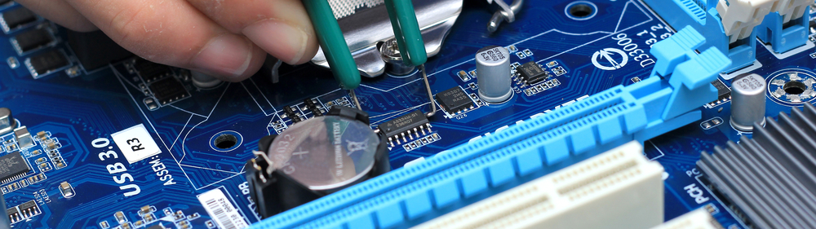
Designing with High Speed Interfaces
Debugging techniques and design considerations
Francesco Contu
HS and RF System Solution Expert EMEA

Slide 2
Agenda
Introduction
TX emphasis
RX linear equalizer
RX DFE
AMD Transceiver tools
IBERT demo

Slide 3
MGT history
First devices appeared around 2000
Mainly dictated by 10G Ethernet and STM16
NRZ encoding, Speed up to 3.125 Gbits, limited equalization
Quickly evolved to 10 Gbit/s around 2005
Sophisticated and automatic equalizers, eye scan features
PAM4 appeared around 2015 for speed > 40 Gbit/s
Again dictated by 400G Ethernet
Commercially available devices today:
NRZ 32 Gbit/s
PAM4 112 Gbit/s

Slide 4
AMD Transceiver Block Diagram
Low Jitter
3-tap FIR
Serial Transceiver
PISO
TX Driver
Pre-emphasis
Hard
PCS
Logic
PLL
FPGA Fabric
Serial
Channel
SIPO
RX
CDR
RX
DFE
RX
Linear EQ
RX
DiffAmp
2-D Eye Scan
Fully adapting
> 9dB
Non-Destructive
High Resolution
Fully adapting
>25 db

Slide 5
What is equalization and why it is needed
We transmit a signal S(f) over a media
    f = frequency
    Media can be copper, fiber optics, air...
The media has a transfer function H(f)
    The signal gets attenuated and distorted
We receive S(f)H(f) while we would like to get S(f)
So we need to add a module that implements 1/H(f)
    This is an ideal equalizer
S(f)H(f)(1/H(f)) = S(f)
So equalization is a passive or active circuit that corrects media attenaution and distortion, and it is needed to obtain the transmitted signal again

Slide 6


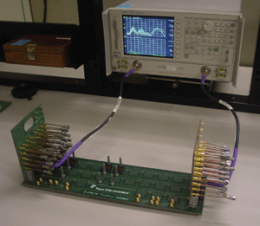
A typical media: the Backplane
(1) Silicon Transceiver
(9) Silicon Transceiver
A backplane is a PCB board that connects connectors so that each pin on each connector is linked to the same relative pin on the other connector(s) forming a data bus.
(2) TX Package TP(f)
(8) RX Package RP(f)
(3) TX Line Card TL(f)
(7) RX Line Card RL(f)
(4) TX Connector TC(f)
(6) RX Connector RC(f)
(5) Backplane B(f)
H(f) = TP(f)TL(f)TC(f)B(f)RC(f)RL(f)RP(f)

Slide 7
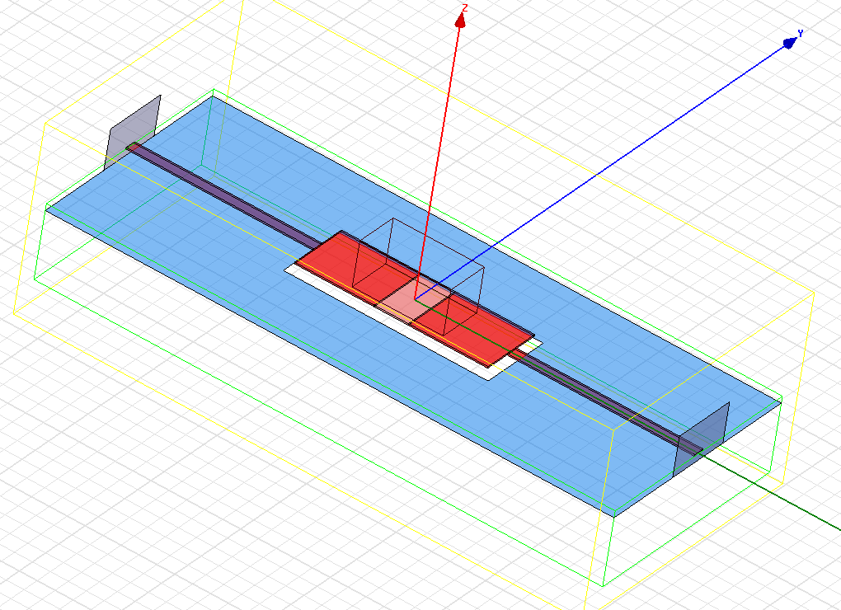
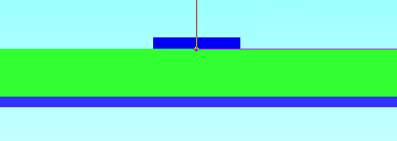
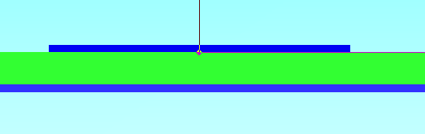
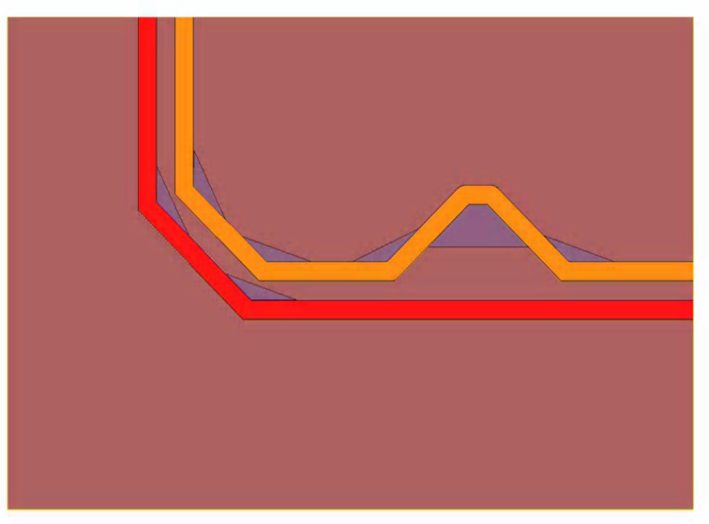
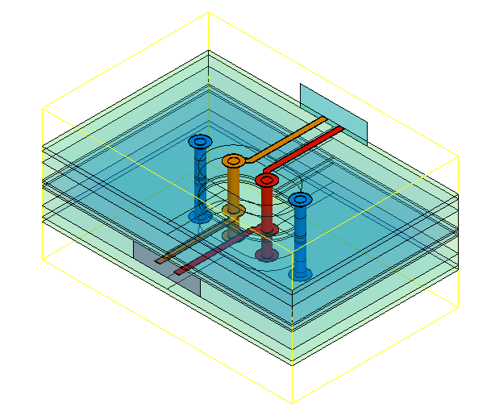
Layout discontinuities
Attenuation is only a small piece of the story
Vias, Connectors, P/N impairements, pads all generate discontinuities
Significantly contribute to distort the signal
Problem start to be very serious around 10 Gbit/s
5mil trace
28mil pad
Plane cut-outs
jog-out
Two 45-degree turns

Slide 8
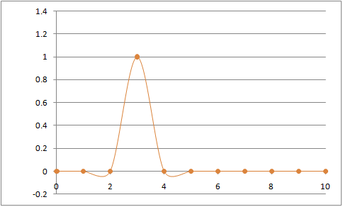
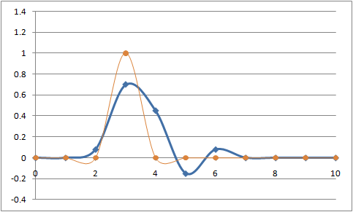
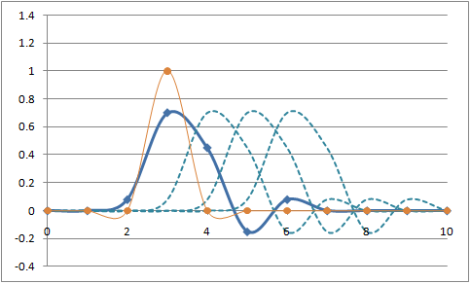
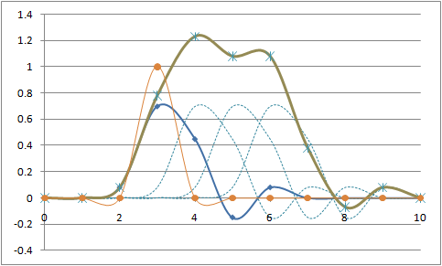
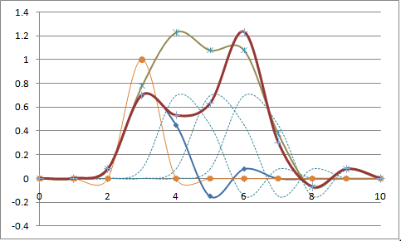
Inter-Symbol-Interference and Equalization
Inter-Symbol-Interference (ISI)
  An impulse response through a channel can expand to other symbols hence impact the waveforms at other symbols
Equalization - Mitigate ISI to ensure correct data sampling
011110
UI Delayed 010s
010110
Ideal 01000
Real 01000

Slide 9
Equalization techniques
TX Emphasis
    Predistorts TX to anticipate channel losses
RX linear equalizer
    Compensates Channel Losses trying to implement 1/H(f)
RX non linear digital equalizer
    AKA Decision Feedback Equalizer
    Compensates intersimbolyc interference

Slide 10
TX Emphasis

Slide 11
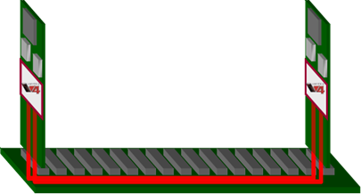
TX Emphasis To Reduce Loss
Transmitted Pulses
Received Pulses
Amplitude
Time
Time

Slide 12
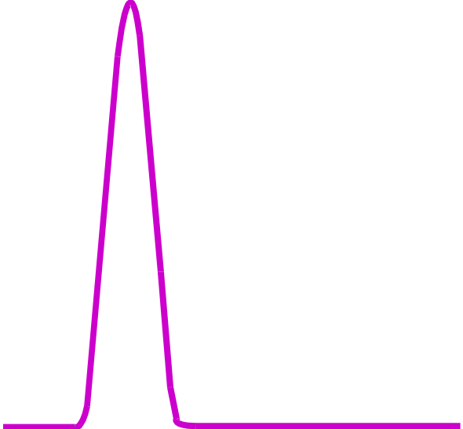
TX Emphasis To Reduce Loss
Transmitted Pulses
Received Pulses
Cursor (tap #1)
Amplitude
Time
Time

Slide 13
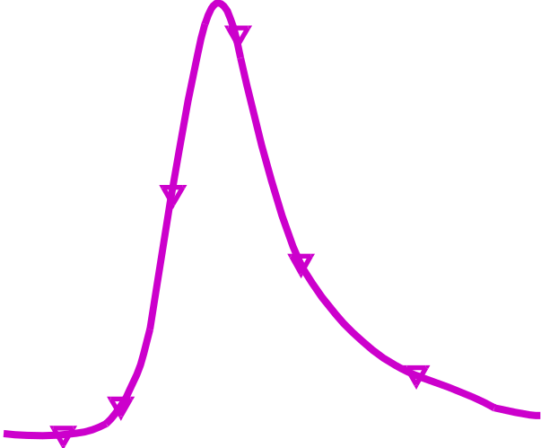
TX Emphasis To Reduce Loss
Transmitted Pulses
Received Pulses
Cursor (tap #1)
Degraded Pulse
Amplitude
Time
Time

Slide 14
TX Emphasis To Reduce Loss
Transmitted Pulses
Received Pulses
Cursor (tap #1)
Degraded Pulse
Amplitude
Pre-cursor (tap #2)
Time
Time

Slide 15

TX Emphasis To Reduce Loss
Transmitted Pulses
Received Pulses
Cursor (tap #1)
Degraded Pulse
Amplitude
Pre-cursor (tap #2)
Pre-cursor
Time
Time

Slide 16

TX Emphasis To Reduce Loss
Transmitted Pulses
Received Pulses
Cursor (tap #1)
Degraded Pulse
Amplitude
Post-cursor (tap #3)
Pre-cursor (tap #2)
Pre-cursor
Time
Time

Slide 17

TX Emphasis To Reduce Loss
Transmitted Pulses
Received Pulses
Cursor (tap #1)
Degraded Pulse
Amplitude
Post-cursor (tap #3)
Pre-cursor (tap #2)
Pre-cursor
Post- cursor
Time
Time

Slide 18
TX Emphasis To Reduce Loss
Transmitted Pulses
Received Pulses
Cursor (tap #1)
Degraded Pulse
Cursor (composite)
Amplitude
Post-cursor (tap #3)
Pre-cursor (tap #2)
Pre-cursor
Post- cursor
Time
Time

Slide 19

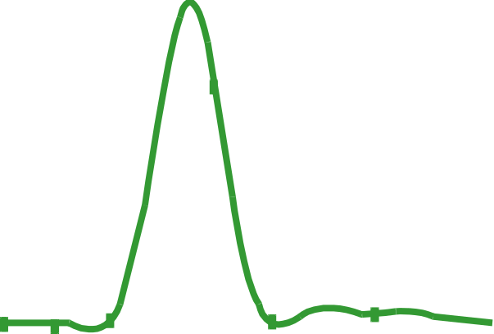
TX Emphasis To Reduce Loss
Transmitted Pulses
Received Pulses
Cursor (tap #1)
Degraded Pulse
Cursor (composite)
Amplitude
Improved Pulse
Post-cursor (tap #3)
Pre-cursor (tap #2)
Pre-cursor
Post- cursor
Time
Time

Slide 20
TX Emphasis side effects
Higher TX power
Higher spectral content
Higher Xtalk
Higher sensitivity to layout discontinuities
    Vias, Connectors, any impedance change
  Manual Process

Slide 21
RX Linear Equalizer

Slide 22
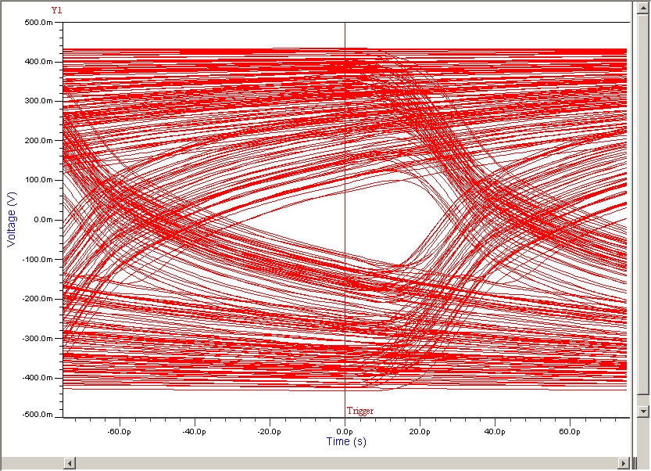
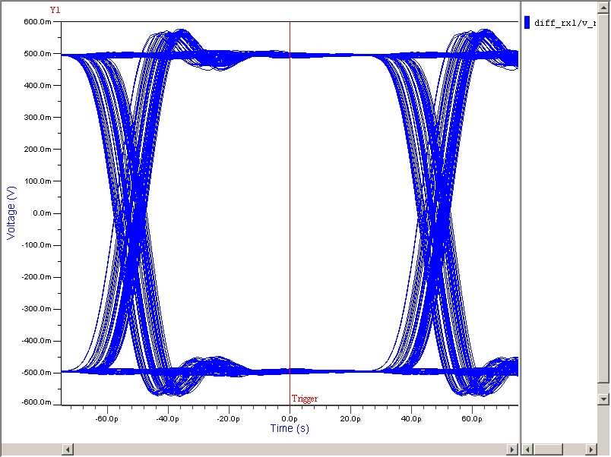
RX Linear Equalization – Loss Compensation
Channel Loss
CTLE
Combined Frequency response
+
=>
No equalization
Full equalization

Slide 23
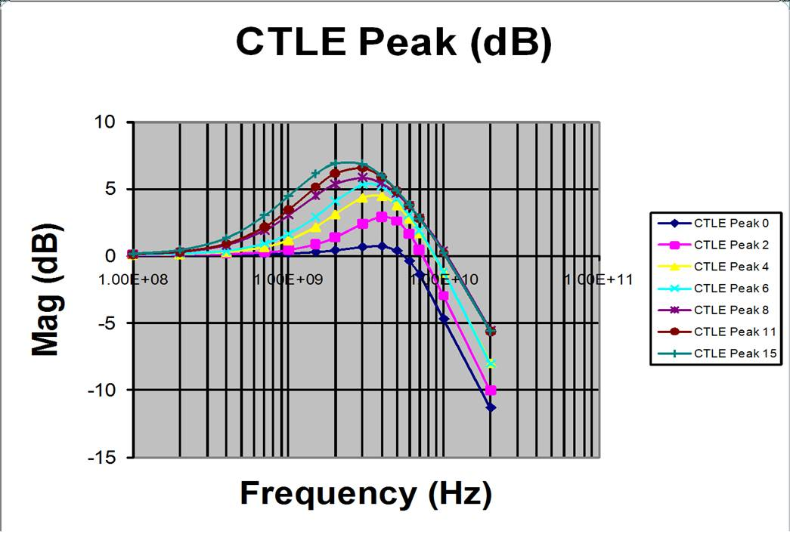
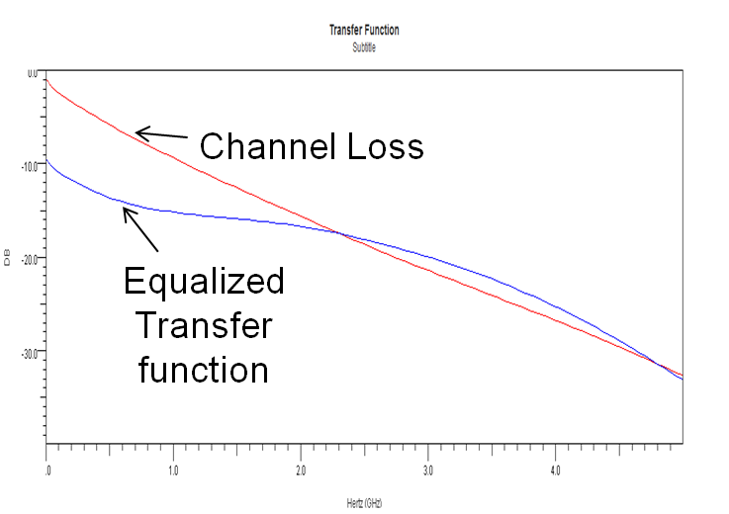
Linear Equalization
  Receiver: Boosts high frequency
  Compensate insertion loss
  Can be tweaked manually or automatically
    Automatic introduced with AMD 7 Series
  Limitation: Boost high frequency noise, including Xtalk
  Recommended for:
    Repetitive patterns
      Example: GEthernet with lots of interframe gaps
    <10 db attenuation
    Clean channels (low noise, low Xtalk)
    Good return loss <-10 db
RX linear equalizer frequency response

Slide 24
Decision Feedback Equalizer

Slide 25
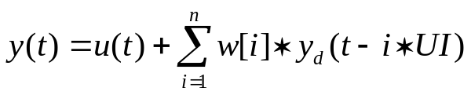
Decision Feedback Equalization
  A nonlinear equalizer that uses previous symbols to eliminate the Inter-Symbol-Interference (ISI) on current symbol.
    The ISI on current symbol, caused by previous symbols, is subtracted by DFE.
Adder to Feedback
Equalized output
Slicer for Decision
RX
u(t)
+
y(t)
y_{d}(t)
X
X
X
X
W[n]
W[3]
W[2]
W[1]
Multiplier
Tap Weight
Z⁻¹
Z⁻¹
Z⁻¹
Unit Delay

Slide 26
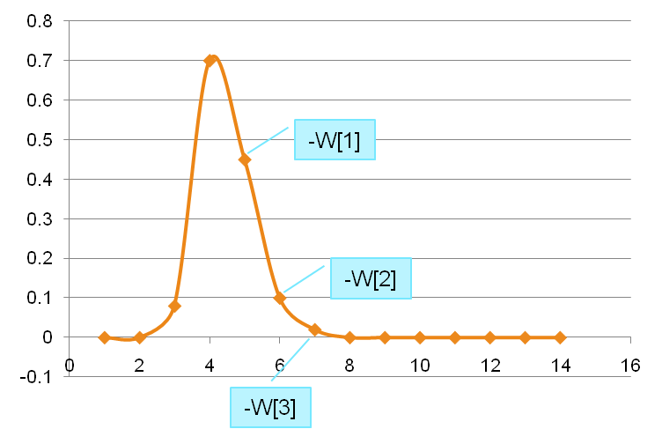
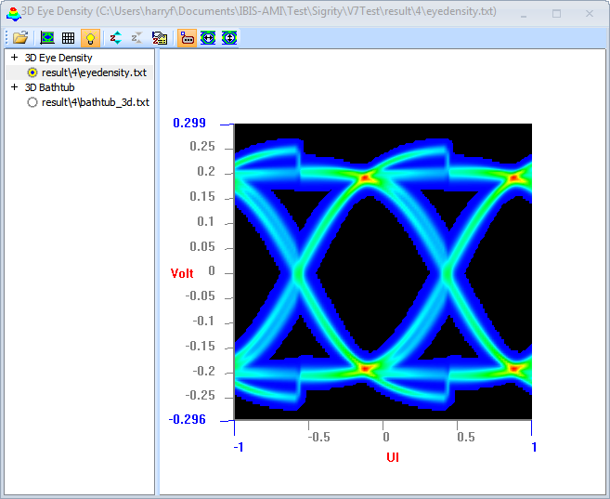
DFE pros and cons
Tap weight
    Can be set automatically
    Adaptation algorithms are well known
    Hard to set manually
Automatic algorithm
    Works best with scrambled data streams
    Can be fooled by long repetitions of the same pattern
    Worst case is “10101010”
    Freezing the taps in this case solves the issue
Error propagation
    Unlikely to happen, yet possible
Does NOT amplify noise
    Best solution for noisy channels
    Main reason why it works better than Linear equalizers in a real system
Tap weight based on ISI

Slide 27
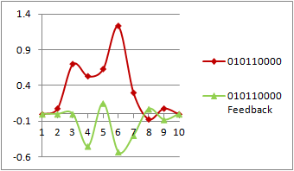
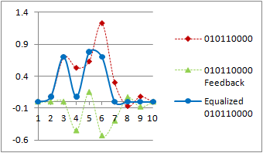
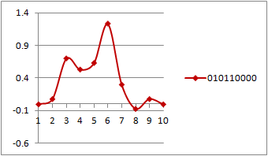
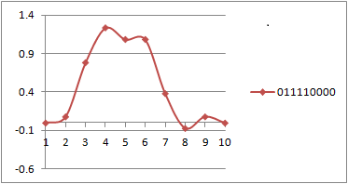
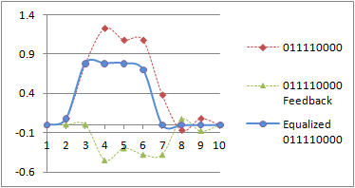
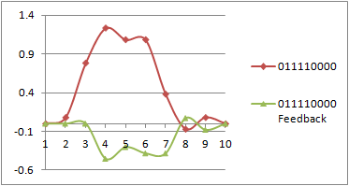
DFE Effect

Slide 28
Equalizer reset
AMD has automatic equalizers since the 7 Series introduction
Excellent performance and dynamic adaptation
Require reset in case of LOS (Loss Of Signal)
Without reset, the equalizer might converge suboptimally

Slide 29
AMD Transceiver Tools:
GT Wizard

Slide 30
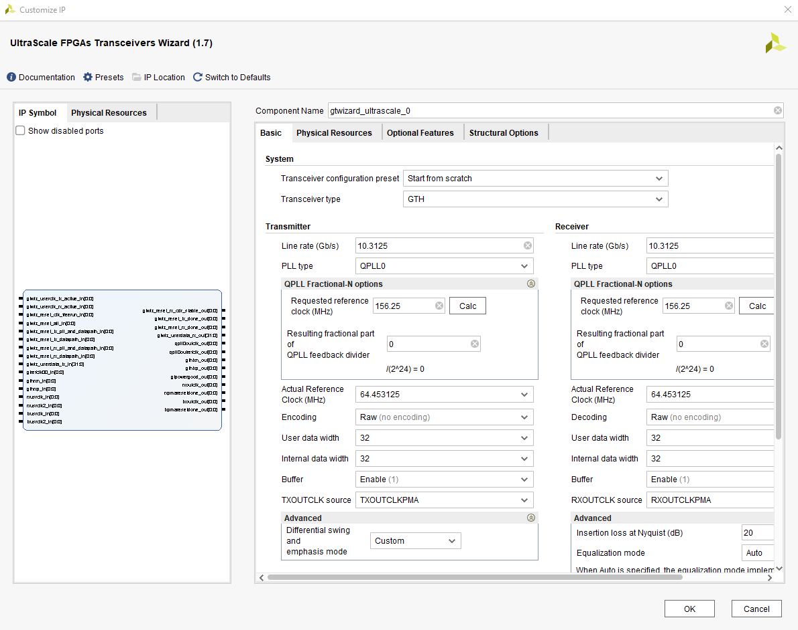
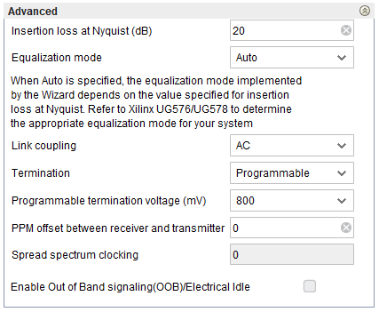
F.F.F.: Frequently Forgotten Feature
You MUST set the equalizer accordingly to your board attenuation
#1 source of non working designs
Defaults to 20 dbs
    Overkill for most designs
    Translates into DFE
    Not good for most 8b/10b applications

Slide 31
AMD Transceiver Tools:
IBERT and In-system IBERT

Slide 32
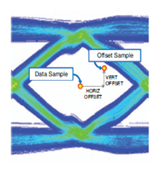
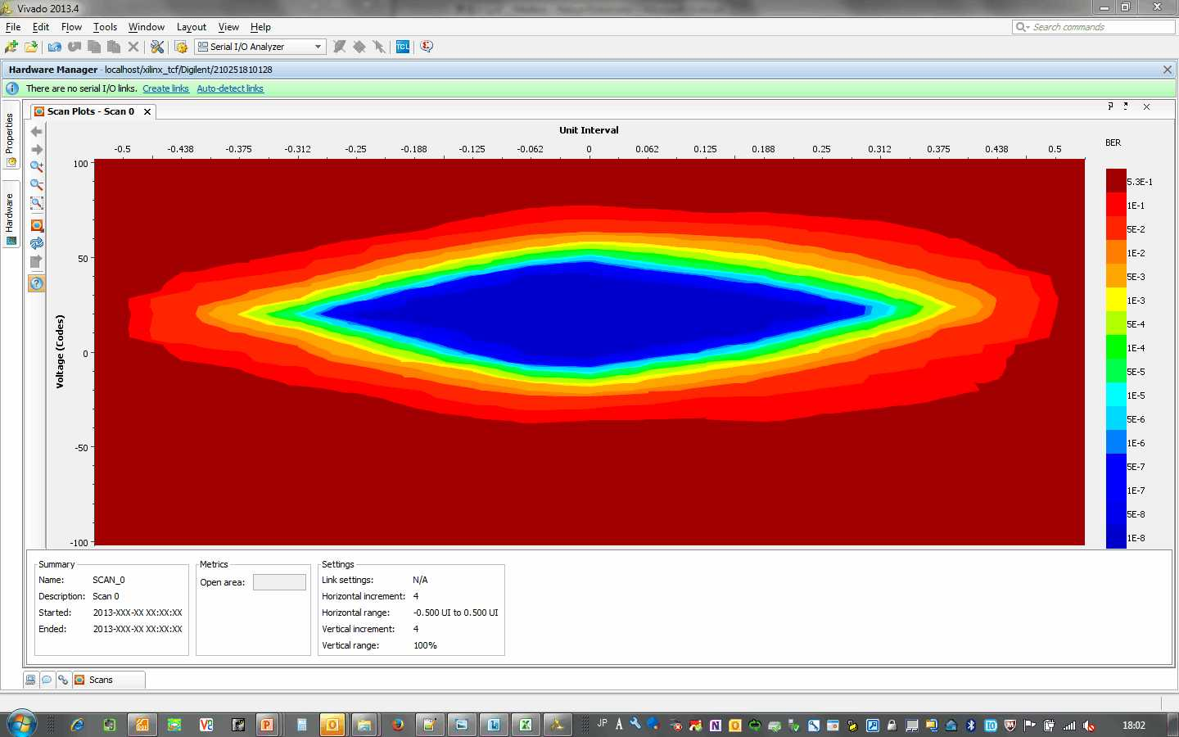
System Analysis with Eye Scan
Non-Destructive On-Chip Debug
Internal Scan History in Xilinx
  Multi-generations of 1-D BER plot
  From Gen 4 to Gen 6
Two Samplers in RX Path
  Data Sampler at the eye center
  Moveable Offset Sampler
  Compare two samplers
  2-D BER Eye built from error location
Eye Scan inside receiver on live data
  Non-destructive
  Post equalization
  BER Measurement
  2-D Plot
  Pattern agnostic

Slide 33
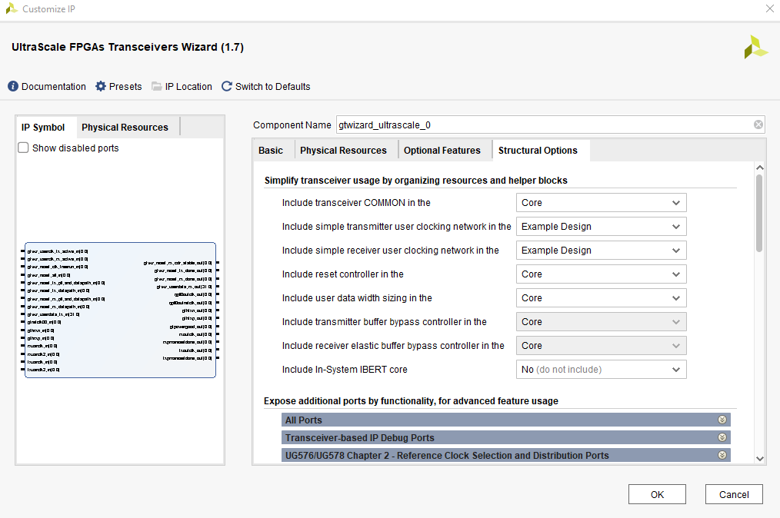
In-System IBERT (yet another F.F.F.)
Eye Scan, Equalizer selection and TX tuning
All directly from your own design
Easily added from the GT Wizard and included in the example design
Available as an add-on IP as well
Ultrascale IP
Some XAPP exists for 7 series
Versal has it in HW automatically

Slide 34
Power and Clocking
It is critically important to satisfy the AMD requirements in terms of power and clocking
Max power noise is normally reported in the PCB design user guide
Required Clock Phase Noise is in the DS or in Answer Records (for older families)
Very often a clock out of spec results in a GT which works looped back
It may also work when connected to a GT making use of the same clock

Slide 35




Clocking solutions
Silica has multiple clocking solutions from timing market leaders
Clock distribution, cleanup and Generation
PLLs up to 18 Ghz
Best in class TCXO and OCXO with leading Temperature and Vibration stability
Quartz and MEMS based

Slide 36
IBERT demo

Slide 37
Thank you!
Questions?

