Slide 1
Welcome
Massimiliano Pulice MRICS
Chair Advisory Board RICS in Italia

Slide 2
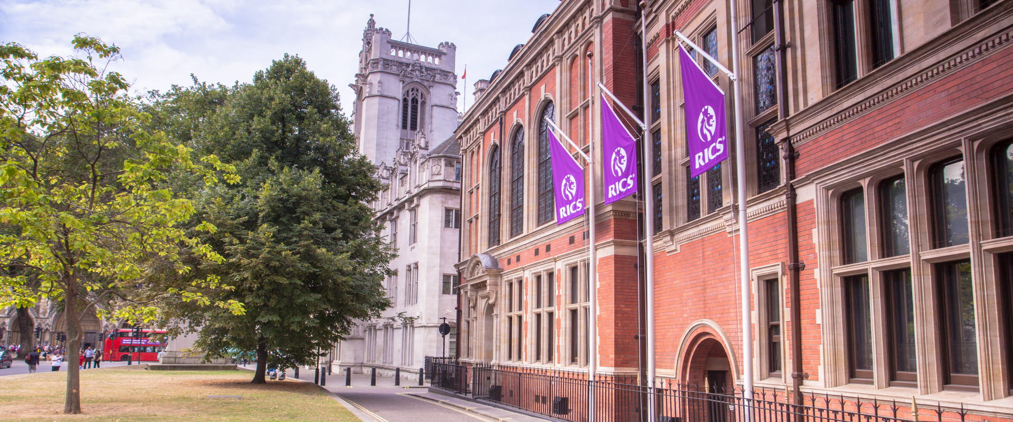

RICS, Royal Institution of Chartered Surveyors, è un’organizzazione professionale globale fondata nel 1868 a Londra, che persegue lo scopo di portare un cambiamento positivo nell’ambiente costruito e naturale.
Attraverso gli standard riconosciuti a livello globale, le iniziative e la Membership, RICS promuove e applica le più elevate prestazioni professionali nella gestione di terreni, immobili, costruzioni e infrastrutture.
L’attività di RICS costituisce le fondamenta per mercati sicuri e crea spazi migliori in cui vivere e lavorare.

Slide 3


Protect the public interest
Professional standards
Build trust and confidence
Notes:
The global adoption of RICS standards creates a consistent basis for measurement, valuation and commonly agreed facts about the built and natural environment. This enables confident investment, trade and economies.
Examples of how our work is driving confident markets
IPMS
Adoption of International Property Measurement Standards (IPMS) by the Administration Committee of Beijing, which opened the way for RICS to participate in a Chinese government-backed coalition of leading real estate decision makers.
ICMS2
The International Air Transport Association adopted International Construction Measurement Standards (ICMS2), which will require all parties involved in airport development, airport planning, capacity planning and terminal planning to deliver aviation infrastructure to a common standard.

Slide 4



Americas
Middle East
& Africa
Presenza Globale
Europe
China
UK & Ireland
135,000
South Asia
Membri e candidate RICS
South East Asia
148
Australia &
New Zealand
Paesi
Notes:
135.000 Membri in 148 Paesi – Nella nuova strategia: RICS a WORLD CLASS ORGANIZATION

Slide 5
RICS in Europa è in crescita
2500
2000
1500
1000
>10k
500
1000
Membri e candidate RICS
Germany
France
Austria
BelLux
Greece
Hungary
Romania
Netherlands
Sweden
Italy
Spain
Other
Switzerland
Poland
Cyprus
Czech Republic
Denmark
Portugal
Finland
56
Corsi in Università accreditate RICS
Notes:
Sempre più focus su Europa per RICS - Italia Paese con Maggiore sviluppo per RICS in EU

Slide 6

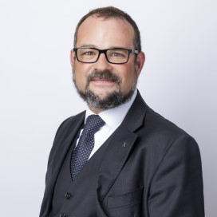
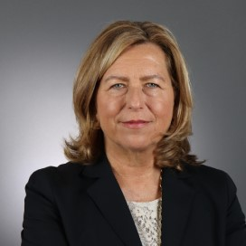

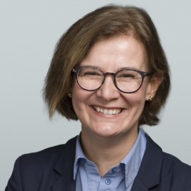
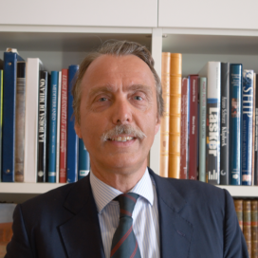

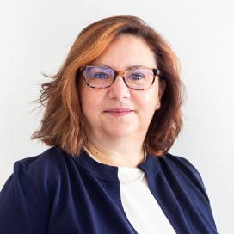
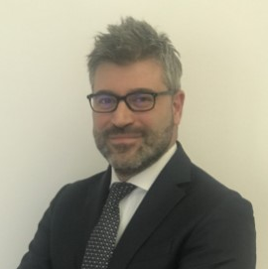
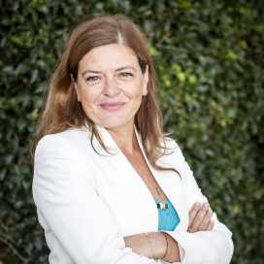
Regional Advisory Board of RICS in Italia
Massimiliano Pulice MRICS
Chair
Nicola Arcaini MRICS Residential
Giulia Comparini MRICS Future of the profession
Antonella Faggiani MRICS
Regioni e Territori
Raffaella Peloso MRICS Valuation
Marco Plazzotta FRICS
Property & Investment
  700
Barbara Polito FRICS Sustainability
Andrea Radice MRICS Construction & QS
Francesca Zirnstein MRICS Relazioni con le Istituzioni
Members and candidates
Notes:
ITALIA PAESE STRATEGICO PER RICS
NOI COME CHAPTER ITALIA VOGLIAMO CONTRIBUIRE A GLOBAL STANDARD / WORKING GROUP ETC
Es. Giacomo Morri nel Leaders Forum ESG & Valuation EU, Antonio del Buono coordina il LFEV in Italia
Collegio Ingegneri e Architetti è nella coalizione IFSS International Fire Safety Standard
Porteremo gli standard globali in Italia (Whole Life Carbon Assessment, IPMS International Property Measurement Standard)

Slide 7
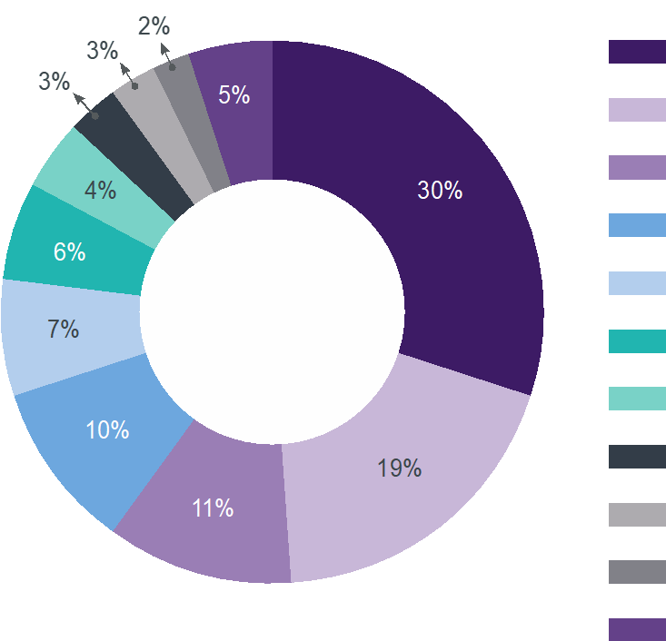










Membri Europei
per area
Commercial Property
Notes:
20 pathways - reflecting the diverse professions represented byRICS

Slide 8
…operating
in the main areas of
land
construction &
infrastructure
property
Notes:
Surveyors work closely with a wide range of people: architects and engineers, bankers and ecologists, town planners and property developers. And they use the latest technologies: flying drones to map land and measure buildings, creating virtual reality models of buildings, and using Big Data to tackle global issues like climate change, migration and urbanisation.
There are more than 100 varied career roles across the surveying profession in three main sectors: construction and infrastructure; property; and land.
We saved this conversation. You'll see it soon in the Conversations tab in Skype for Business and in the Conversation History folder in Outlook.
Land
RICS professionals working in the land sector are wide and varied from those surveying land for development purposes, looking at neighbourhood matters (rights of light, party walls, etc), valuation of land and feasibility for development for affordable housing.
Construction and infrastructure
RICS professionals in construction and infrastructure are responsible for project and financial management of all types of construction and infrastructure work from cost advice on building a new block of flats to procurement direction on Crossrail, contract management of the supply chain for major developments in the middle east. Their skill is in delivering these projects to time and budget requirements and ensuring the accurate forecasting and prediction of costs.
Property
RICS professionals working in property tend to be focused on helping clients either find space to have their office/shop or working with landlords to find people to occupy offices/shops. They help with the lease management and negotiate on their behalf to get the best deal. They also value assets and advise clients on getting the most our of their property assets. They also buy and sell real estate and increasing work in financial services on fund management of major property investments.
All RICS professionals are increasing looking to do things more sustainably utilising the benefits of new technologies and data and to the highest ethical standards.

Slide 9



Slide 10
Global Standards &
Ethical Principles

Slide 11

Why do we need International Standards?
“As a consequence of globalization, market efficiency requires market consistency, transparency and comparability.
International standards are
the backbone”
- World Bank

Slide 12
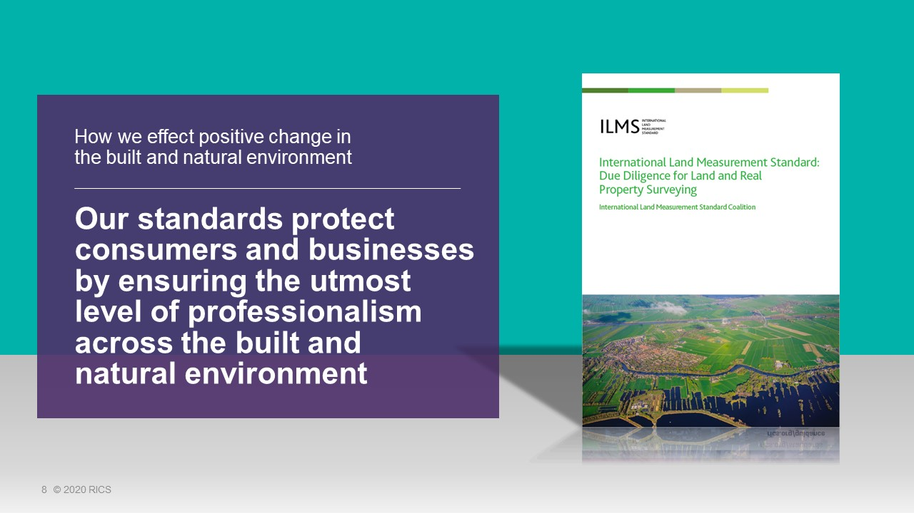
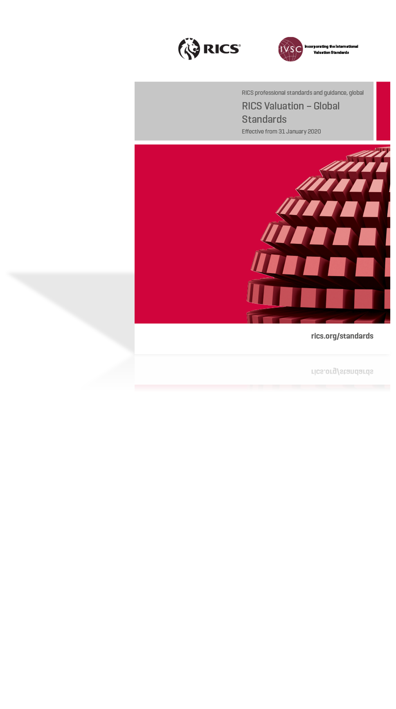
Notes:
The “why” of our standards
80% of respondent from the Survey of the Profession state that RICS effectively regulates to protect the public and profession
Examples of different RICS standards:
Red book / International Property Measurement Standards (IPMS) / Rules of conduct for members / Anti-money-laundering (AML) / Countering bribery and corruption
Examples of different RICS standards in practice:
IPMS
Adoption of International Property Measurement Standards (IPMS) by the Administration Committee of Beijing, which opened the way for RICS to participate in a Chinese government-backed coalition of leading real estate decision makers.
IPMS
The International Air Transport Association adopted International Construction Measurement Standards (ICMS2), which will require all parties involved in airport development, airport planning, capacity planning and terminal planning to deliver aviation infrastructure to a common standard.

Slide 13

Rules of Conduct and Global Ethical Principles
Setting RICS professionals apart is not only our technical expertise but also the standards of ethical practice that we support and enforce across the profession

Slide 14



Rules of Conduct and Global
Ethical Principles support members and firms to make complicated decisions about what is the right thing to do
Protecting Members from Complaints
Helping the public have confidence that members and firms use their skills and knowledge fairly and in the public interest
Protecting clients from being
exploited or getting
a poor service

Slide 15
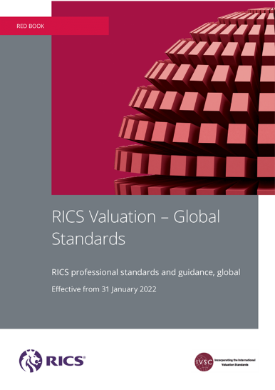

RICS Global Valuation Standards
Notes:
Our own global valuation standards are embedded in this publication, RICS Valuation – Global Standards, the so called red book, which is produced in conjunction with the International Valuation Standards Council. The most recent version originates from earlier this year and its now translated into several different languages. What RICS is ultimately hoping to achieve by producing such valuation standards and other initiatives is severalfold.
1. First off to develop high quality international valuation standards which underpin consistency, transparency and confidence in valuations across the world;
2. Secondly to be seen and referred to as the standard setter for valuation with international valuation standards which are recognised and over time adopted by key stakeholders around the world;
3. Finally in achieving the above, to add status to RICS member and sponsor organisations and the valuation profession.

Slide 16

Adoptors of the Red Book include:
Finance Ministry - Greece
Advanced Real Estate Solutions (Abu Dhabi Gov)
Broll Property Group
Fortress Real Estate Investment Trust (REIT)
Italian Banking Association (ABI)
Institution of Surveyors of Kenya

Slide 17
Join RICS

Slide 18



There are
three designations of RICS membership
Associate Member
(AssocRICS)
Chartered Member
(MRICS)
RICS Fellow
(FRICS)
Notes:
AssocRICS
Associate Member is the entry-level option and offers the chance to progress to full chartered status.
MRICS
Chartered Member is the most common way to join - most people who join already have surveying-related qualifications and work experience.
RICS Fellow (FRICS) – Our most premium level of membership. All Chartered Members (MRICS) are eligible to apply for fellowship.

Slide 19




Competencies
Case Study
CPD hours
Online module with multiple choice test
Notes:
We assess professional ethics as
a competence before the
APC assessment using…
There are four elements

Slide 20
RICS Matrics
(Early Career Network)

Slide 21

RICS Matrics – Did you know its free??
RICS student status is exclusively for those working towards a professional career in surveying.
Those eligible to become RICS students must be studying towards or have completed a course within land, real estate, construction and infrastructure.
Register online at http://www.rics.org/uk/join/student/

Slide 22

RICS Matrics is a networking and support group within the RICS especially for students, apprentices, trainees and those newly qualified.

Slide 23

RICS MATRICS:
The Purpose
Provides support and personal development to new members entering the profession
Inspires the Next Generation
Provides networking and business contacts
Ensures development, promotion and growth of
the RICS

Slide 24

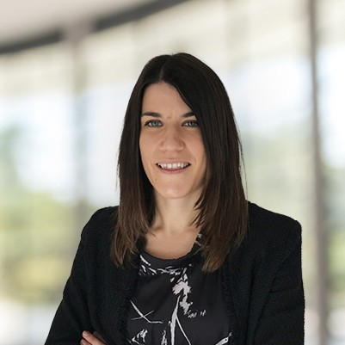



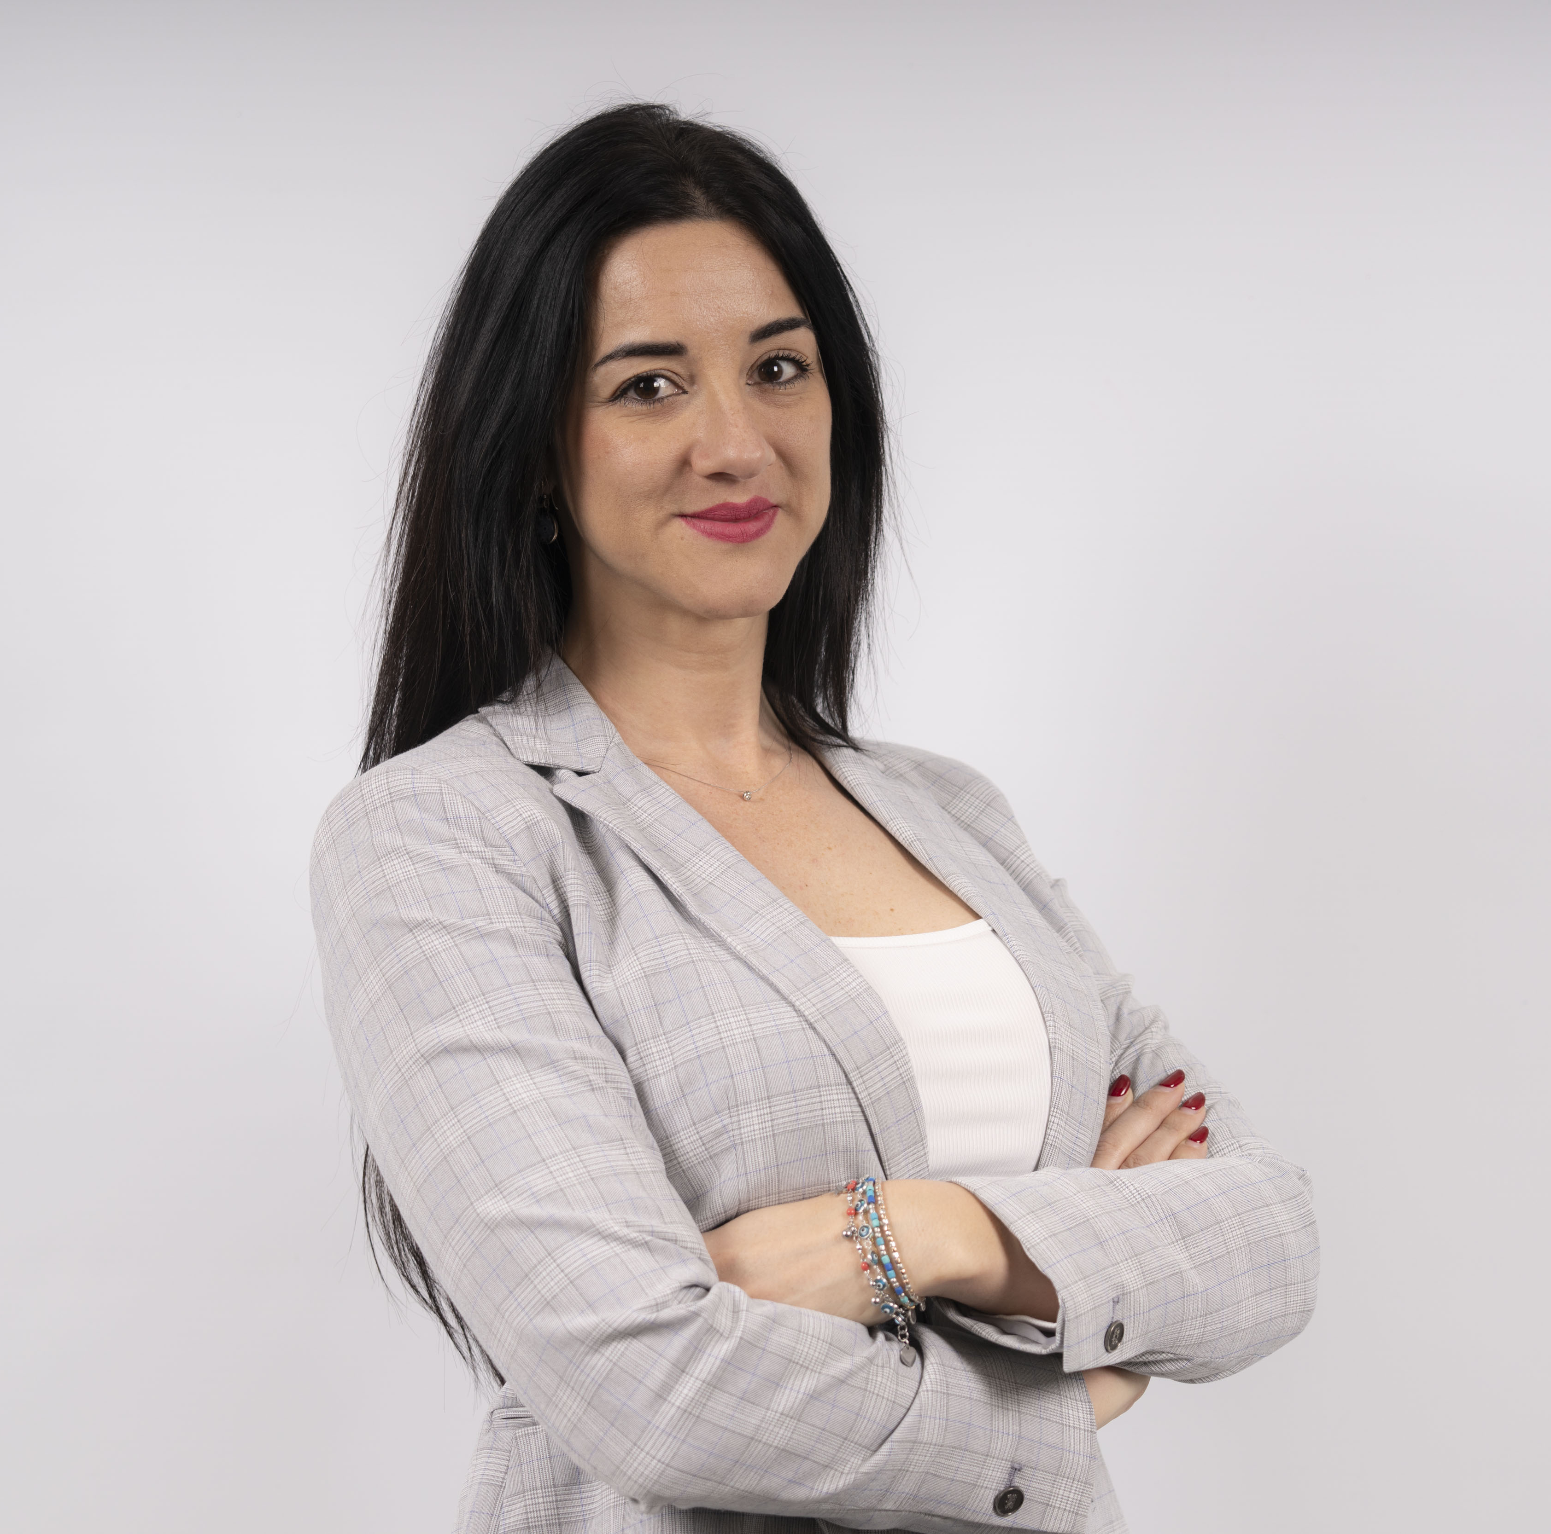

The Italian Committee
Giulia Genoni, MRICS
Veronica Milli, MRICS
Lorenza Cerrone, MRICS
Andrea Mele, MRICS
Matteo Regalli,
MRICS
Melania Arenas Morente, MRICS
Carlo Martucci, MRICS

Slide 25

Useful Links
MRICS qualification
https://www.rics.org/uk/join/member-mrics/
AssocRICS qualification
https://www.rics.org/uk/join/new-associate-assocrics/
Pathway Guides and Templates
https://www.rics.org/uk/apc/pathway-guides
Recognised qualifications for direct entry
http://www.rics.org/uk/the-profession/professional-bodies/
RICS accredited degrees http://www.ricscourses.org/Course/#
APC Candidate support
https://www.rics.org/uk/apc/apc-candidate-support/
Associate Candidate support
https://www.rics.org/uk/apc/associate-candidate-support/
APC Assessment calendar - https://www.rics.org/Global/RICS_Assessment_Calendar_Scot_Eng_wales_RICS_151216_jf.pdf

Slide 26


